Slide 1

Tables, Charts, and Giraffe’s… oh my!

Slide 2

Unveiling
Analyzing Popularity and Cancellation Patterns for Content Optimization
Our goal is to analyze Netflix's vast array of releases to identify patterns in their offerings popularity and cancellation rates. By examining historical data, we seek to uncover insights that could optimize content offerings and marketing strategies.

Slide 3
Questions We Want Answered
What strategic advantages does Netflix gain by continuing to produce a high volume of shows despite a significant percentage of them ending after just one season?
How have external factors such as writers' strikes, layoffs, and production budget cuts impacted Netflix's content production strategy and overall output from 2022 to 2023?
What are the implications of having a large number of one-season shows for Netflix's long-term viewer retention and subscription growth?

Slide 4
1997
2007
2013
2023
Launched as a Rental Service
Streaming Services Introduced
Netflix Original Content
Live Programming
Subscribers were able to select movies and TV shows online and receive disks in the mail with no due dates, late fees, or shipping fees.
Streaming services quickly gained momentum allowing subscribers to stream over the internet.
As streaming became Netflix’ primary source of revenue, content generation gained momentum. By 2023 Netflix had more than 3600 original titles.
Netflix began it’s foray into live streaming Stand-up Comedy and is moving towards live wrestling
https://www.britannica.com/money/Netflix-Inc

Slide 5







Notes:
Award Winning Netflix Content

Slide 6


Raw Data Sources
All Ended Netflix Originals Shows (kaggle.com)
https://www.kaggle.com/datasets/rahulvyasm/netflix-movies-and-tv-shows
https://www.kaggle.com/datasets/shivamb/netflix-shows
Notes:
Reah

Slide 7
Raw Data Sources
Remove Duplicates: Ensure each TV show is listed only once by removing duplicate rows.
Handle Missing Values:
Fill Missing Data: Use appropriate methods to fill missing data, such as mean, median, or a placeholder value.
Remove Missing Data: If data is too sparse, consider removing rows or columns with significant missing values.
Standardize Data Formats:
Dates: Convert date columns to a consistent format (e.g., YYYY).
Text Fields: Ensure text fields (e.g., genre, title) are standardized (e.g., capitalization, spelling).
Extract Relevant Information:
Year Extraction: Create new columns for Premiere Year and Finale Year by extracting the year from date columns.
Genre Standardization: Modify genres for consistency, such as changing "Drama" to "Dramas".
Remove Irrelevant Data: Drop columns that are not necessary for analysis to streamline the dataset.
Convert Data Types: Ensure numerical data is stored in the correct format (e.g., integers, floats) for accurate analysis.
Normalize Data: Standardize ranges of numerical data for consistent comparison and analysis.
Notes:
Reah

Slide 8
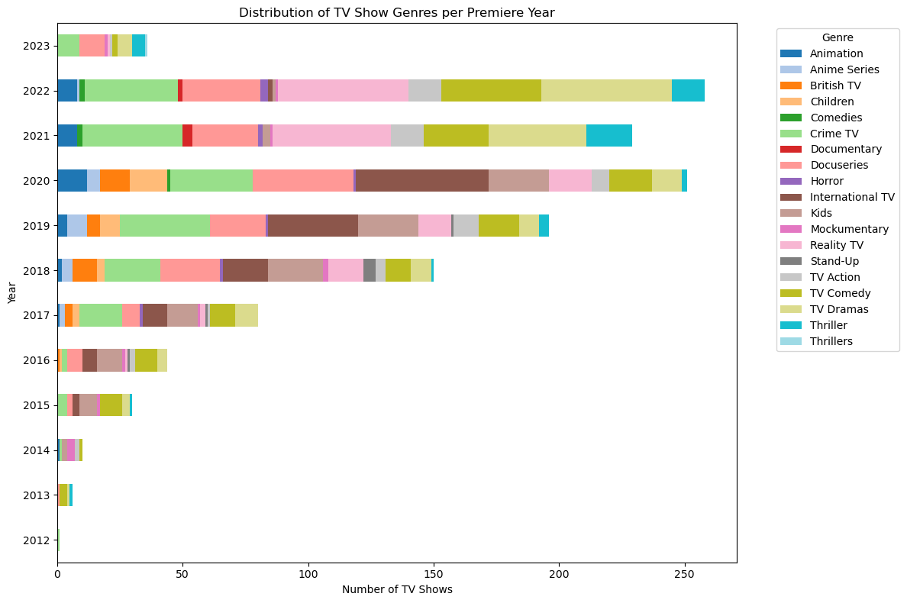
Notes:
Jessica

Slide 9
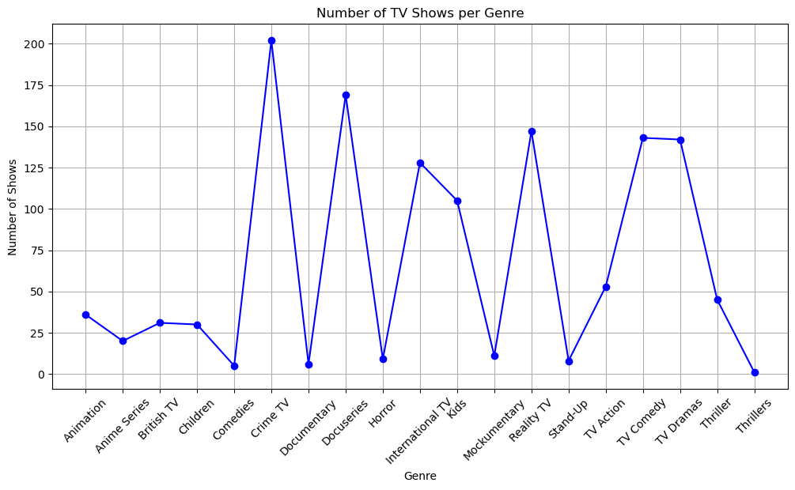
Correlation Between Number of Shows and Genres
Notes:
Tymeeka presenting and providing 2 visualizations

Slide 10
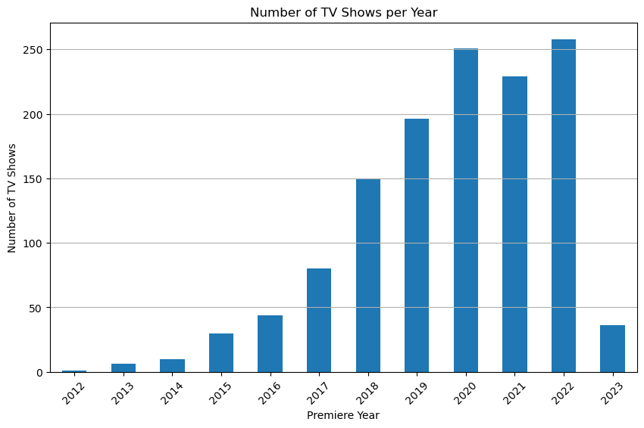
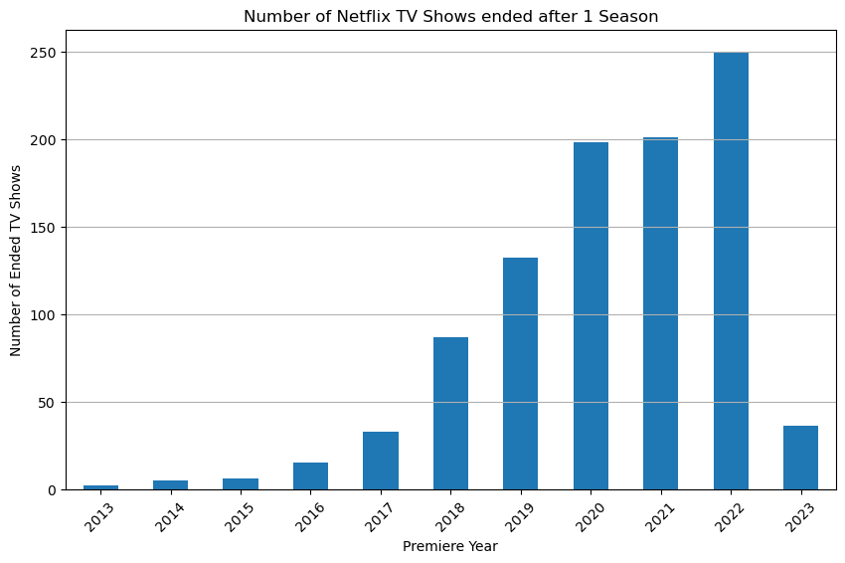
Annual TV Shows Premiered
Notes:
Jessica

Slide 11
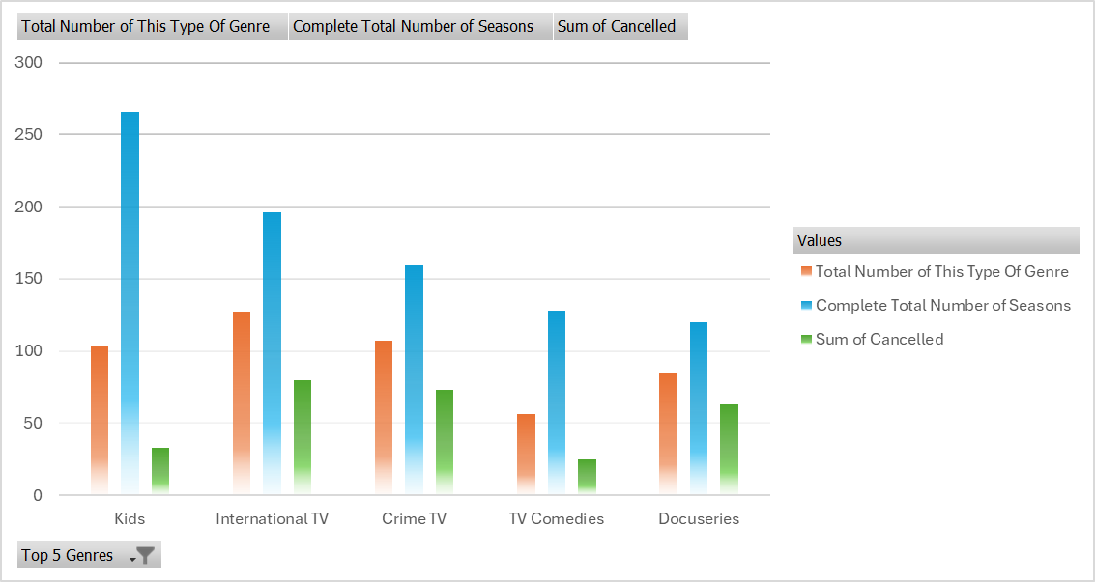
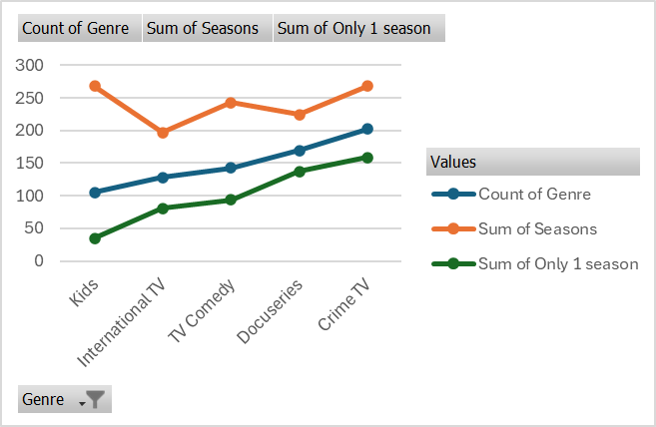
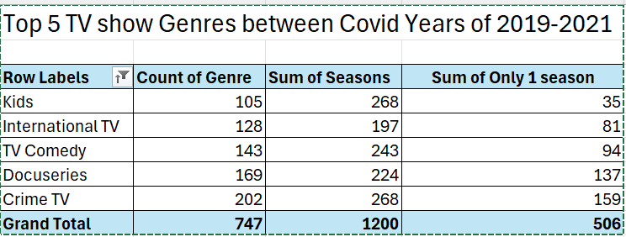
Top 5
Show Genres
Notes:
Tymeeka I wanted to see what were the top 5 TV Show genres
within a 3 year period of pre and post covid years, so between 2019 & 2021, based on the number of seasons each produced.

Slide 12
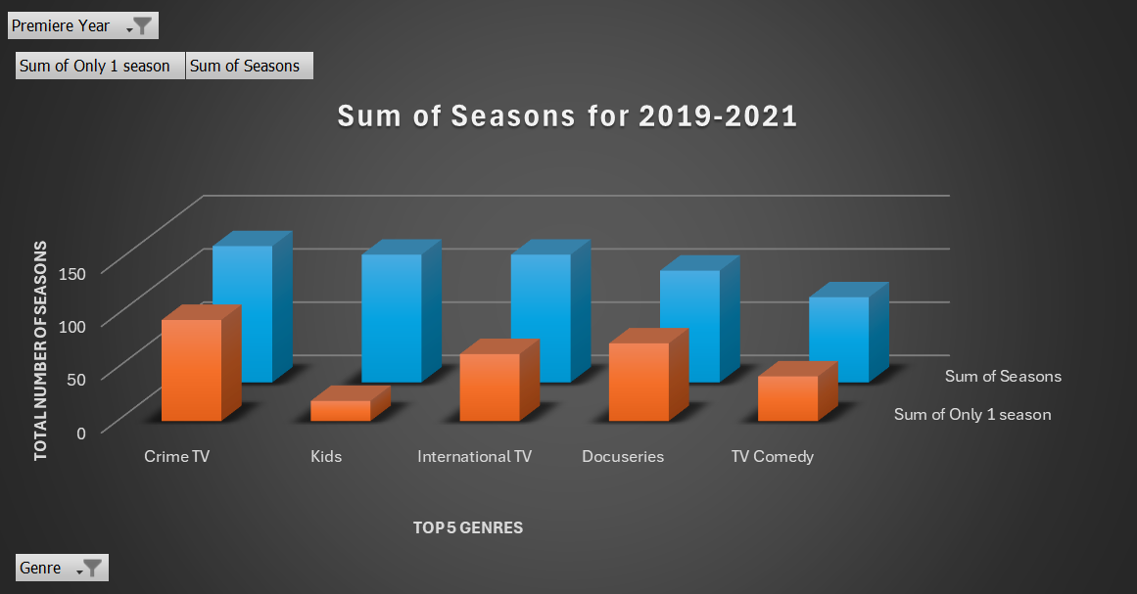
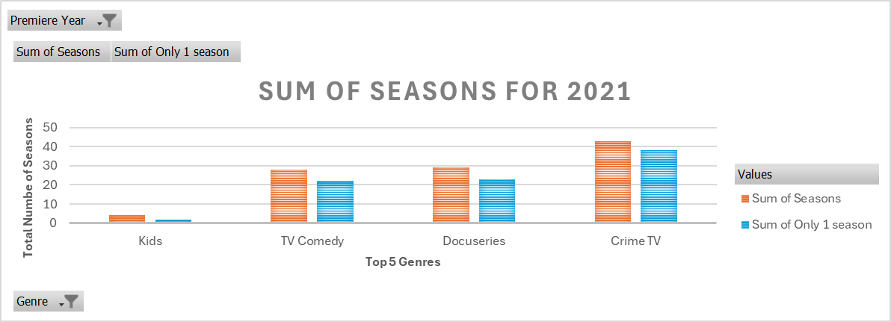
2019-2021 Sum of Seasons
Notes:
Tymeeka 53%

Slide 13
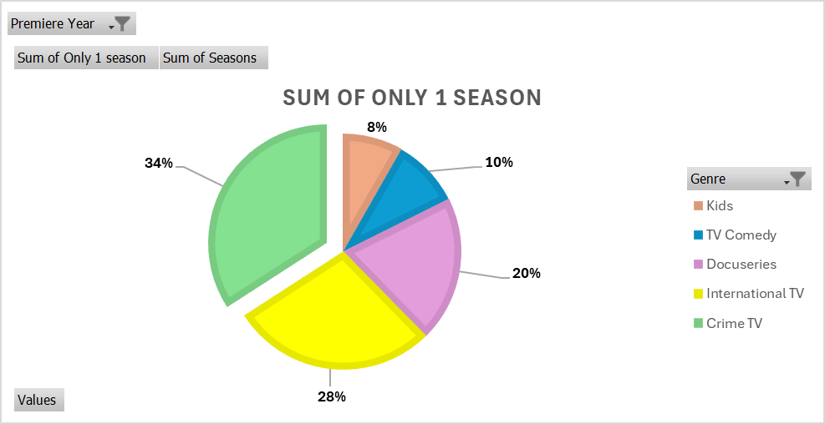
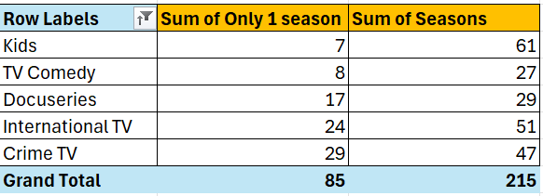
2019 Sum of Seasons
Notes:
Tymeeka 53%

Slide 14
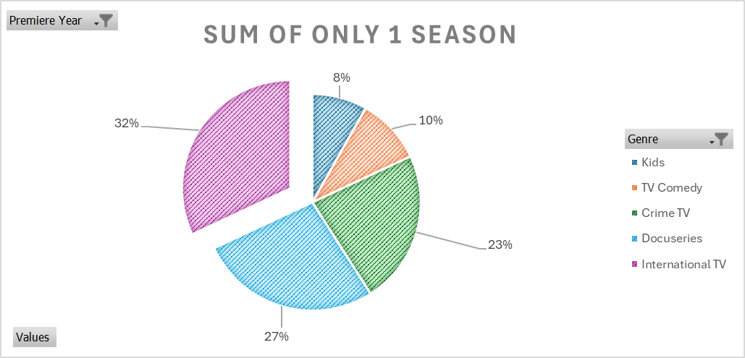
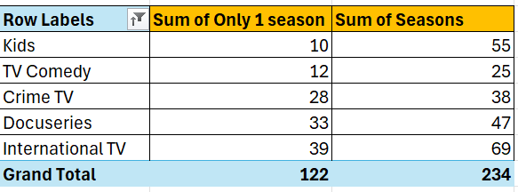
2020
Sum of Seasons
Notes:
Tymeeka 53%

Slide 15

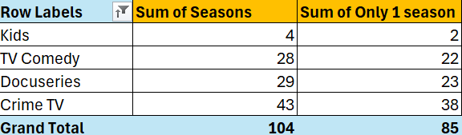
2021 Sum of Seasons
Notes:
Tymeeka the percent of seasons with only 1 show =83%. This represents the total number of shows with 1 season vs their total number of seasons

Slide 16
Surprises
Average Seasons: 1.833
Impact of Writer's Strike and Budget Cuts/Layoffs
Surge in Dramas and Reality TV During Lockdown

